Slide 1
STUDENT DETAILS
STUDENT NAME: SHYAM SUNDHAR .B
REGISTER NO AND NMID:222403601 & BE3882B09E07952B4184905205706E74
DEPARTMENT: BSC COMPUTER SCIENCE WITH AI
COLLEGE:SRIDEVI ARTS AND SCIENCE COLLEGE

Slide 2
PROJECT TITLE
CATCH THE BALL GAME

Slide 3
AGENDA
1. Problem Statement
2. Project Overview
3. End Users
4. Tools and Technologies
5. Game Design and Layout
6. Features and Functionality
7. Results and Screenshots
8. Conclusion
9. Github Link

Slide 4
PROBLEM STATEMENT
The goal is to create a simple and engaging browser-based game.
Players should be able to click on a moving ball to increase their score.
The project demonstrates the basics of web development and JavaScript game logic.

Slide 5
PROJECT OVERVIEW
Catch the Ball is a mini-game built using HTML, CSS, and JavaScript.
The game displays a red ball inside a box, which moves randomly.
When the player clicks on the ball, the score increases by one.
The objective is to catch as many balls as possible.

Slide 6
WHO ARE THE END USERS?
• Students learning web development.
• Beginners in JavaScript programming.
• People interested in simple interactive games.

Slide 7
TOOLS AND TECHNOLOGIES
• HTML → Game Structure
• CSS → Game Styling
• JavaScript → Game Logic and Event Handling

Slide 8
GAME DESIGN AND LAYOUT
• A white box defines the play area.
• A red ball appears randomly within the box.
• Score is displayed below the play area.
• Simple and user-friendly interface.

Slide 9
FEATURES AND FUNCTIONALITY
• Interactive clicking mechanism.
• Score increases on each successful click.
• Random ball movement after every click.
• Real-time score updates.
• Lightweight and runs in any browser.

Slide 10
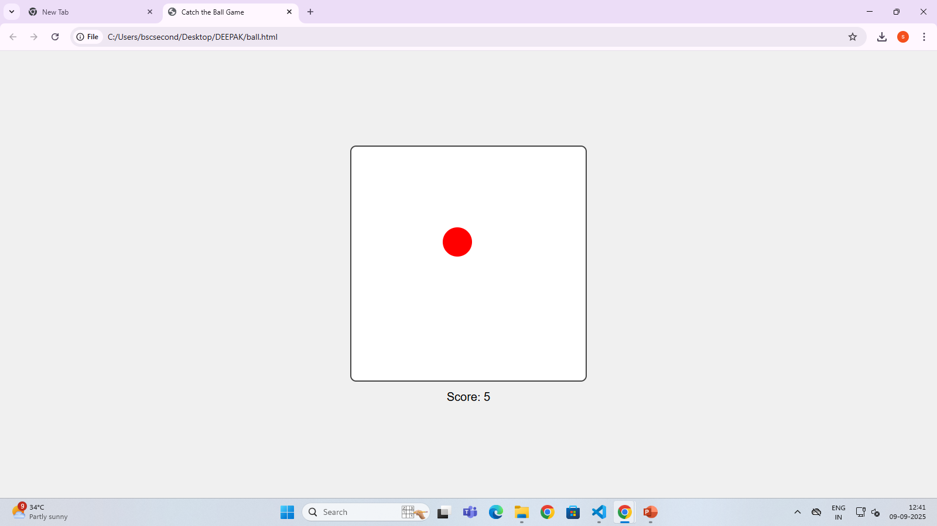

Slide 11
CONCLUSION
• Catch the Ball is a fun and educational game project.
• It strengthens JavaScript and DOM manipulation skills.
• Demonstrates the integration of HTML, CSS, and JavaScript.
• A beginner-friendly project for understanding game development concepts.

Slide 12
GITHUB LINK
https://github.com/bshyamsundar24910bscai-design/Shyamsundhar_222403601.git

